Slide 1
Analytics GC - Tape Gang
190100027 - Ashutosh Sharma
190100105 - Satdhruti Paul
200010066 - Aum Samel
Problem Statement And Data Mining from Candlestick Patterns -
The OHLC data gave very less correlation with y, hence new features were engineered inspired from [1]. The new features that gave higher correlation were - Bull Harami Pattern matches, Close of last < Open of new, Pattern 0,2 from [1], and Close > 50% of Prev Candle Height

Slide 2
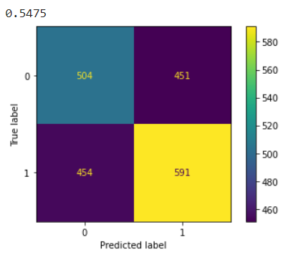
Initial Analysis with RF, Logistic and SVM regressions.
Since our variables are binary, we did not apply normalization as we would lose out on data.
The various accuracies reported on different models tested are as follows -
Random Forest Accuracy = 54.75%, Logistic Regression = 54.85%,
SVM accuracy = 54.75%, XGBoost = 54.9%
These were not above the 55% accuracy point that we aimed to achieve. Hence we proceeded to use LSTM RNNs as it is a time dependent data series.

Slide 3
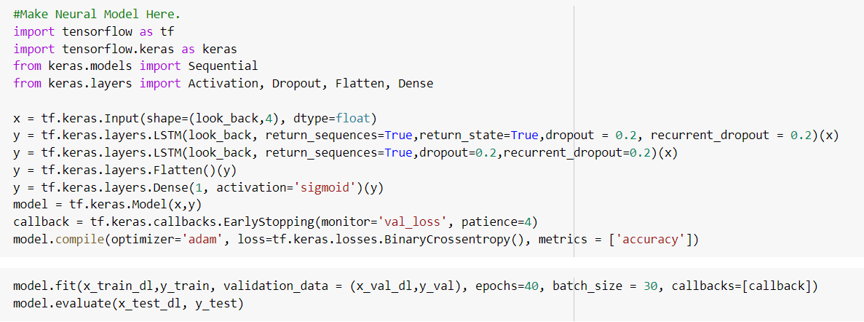
Deep Learning based approach
Since it was a time series data, LSTM based model was used with a special feature for look_out which controlled the amount of time series data required for a single data point for capturing the temporal relation with y.
Various heuristics and hyper parameter tuning resulted in accuracy on test dataset to be around 56.3% (higher than ensemble accuracies)

Slide 4
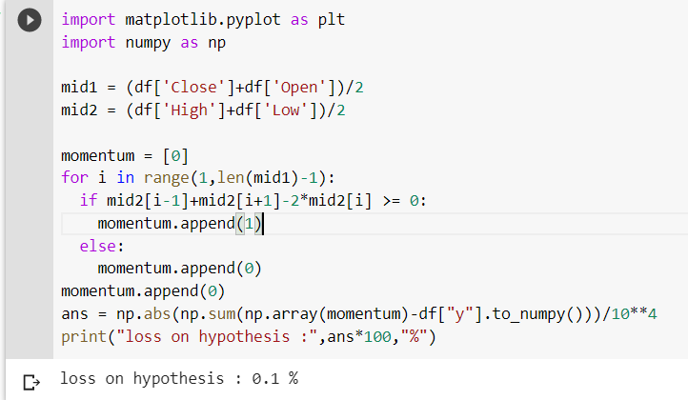
Significance of y and Hypothesis proposed
On searching for significance of OHLC chart [5], we came across term momentum and according to the definition in [6], it is the rate of rise or fall of stock price i.e. double derivative of stock price at any point of time.
We believe y represents increase or decrease in momentum(which represents acceleration in the stock price). If stock price is accelerating, y=1. This hypothesis was tested on the dataset by calculating acceleration in stock price as p(i-1) + p(i+1) - 2*p(i). If this quantity is positive, y is 1 and vice-versa. P here represents stock price calculated as mean stock price at ith time point.
On testing on the labelled dataset, the error on prediction based on Momentum Hypothesis turned out to be 0.1% on an average, which confirms that the quantity ‘y’ represents increase or decrease in rate of stock prices.

Slide 5
References
[1] Deep Candlestick Mining - https://discovery.ucl.ac.uk/id/eprint/10062933/1/ICONIP_Deep_Candlestick_Mining_update_final.pdf,
[2] Mid Range Analysis - https://discovery.ucl.ac.uk/id/eprint/10063445/1/Mann_A%20New%20Methodology%20to%20Exploit%20Predictive%20Power%20in%20(Open%20High%20Low%20Close.._.pdf
[3] And sklearn documentation for different regression hyperparameters.
[4] LSTM based approach - https://machinelearningmastery.com/sequence-classification-lstm-recurrent-neural-networks-python-keras/
[5]Finding significance of y - https://www.investopedia.com/terms/o/ohlcchart.asp
[6] Definition of Momentum -
https://www.investopedia.com/articles/technical/081501.asp#:~:text=%E2%80%8BMomentum%20measures%20the%20rate,more%20often%20than%20they%20fall.

